Slide 1

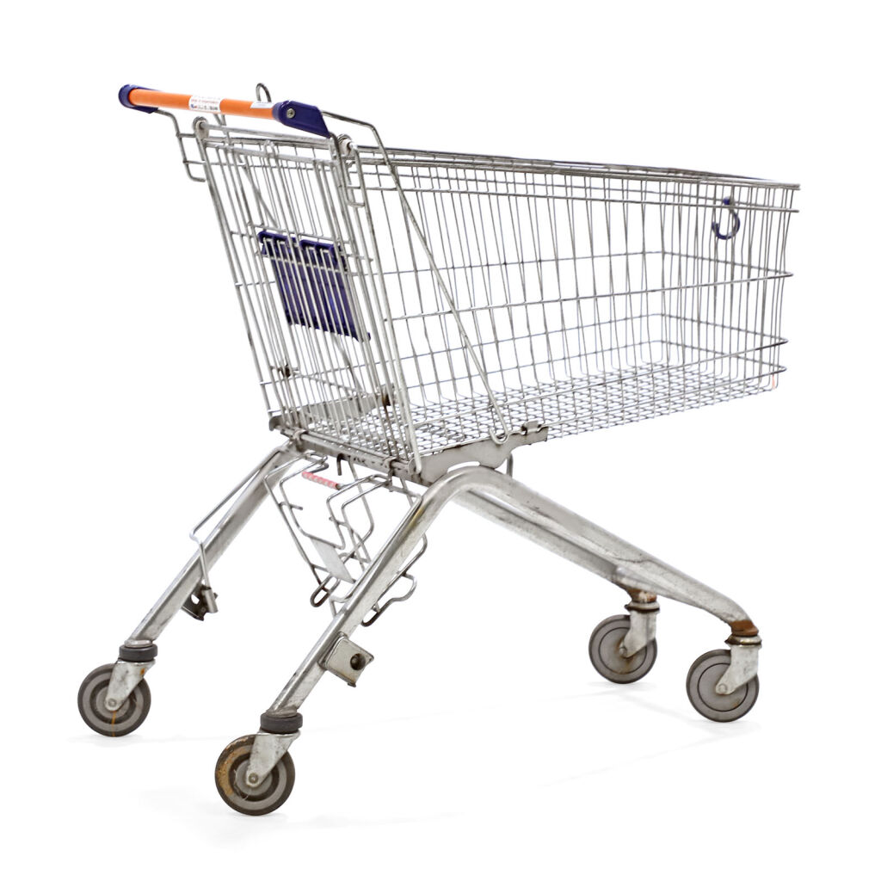
Winkelwagen applicatie

Slide 2

Wat ga je leren?
Gebruik maken van Fixtures (=test data)
Fixtures are used to load a "fake" set of data into a database that can then be used for testing or to help give you some interesting data while you're developing your application.
Gebruiken / aanpassen van een Symfony Service
The functionality of a Symfony application is divided into smaller chunks called services. A service is a PHP object.
Gebruik maken van Sessies
The Symfony HttpFoundation component has a very powerful and flexible session subsystem which is designed to provide session management that you can use to store information about the user between requests through a clear object-oriented interface

Slide 3
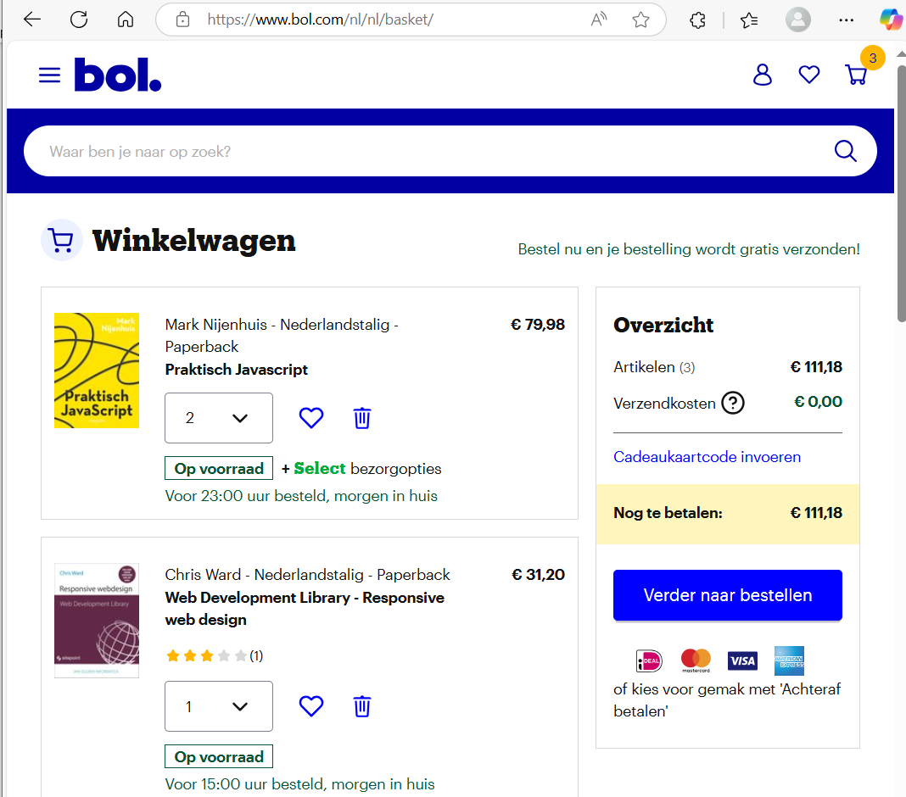
concurrentie onderzoek

Slide 4
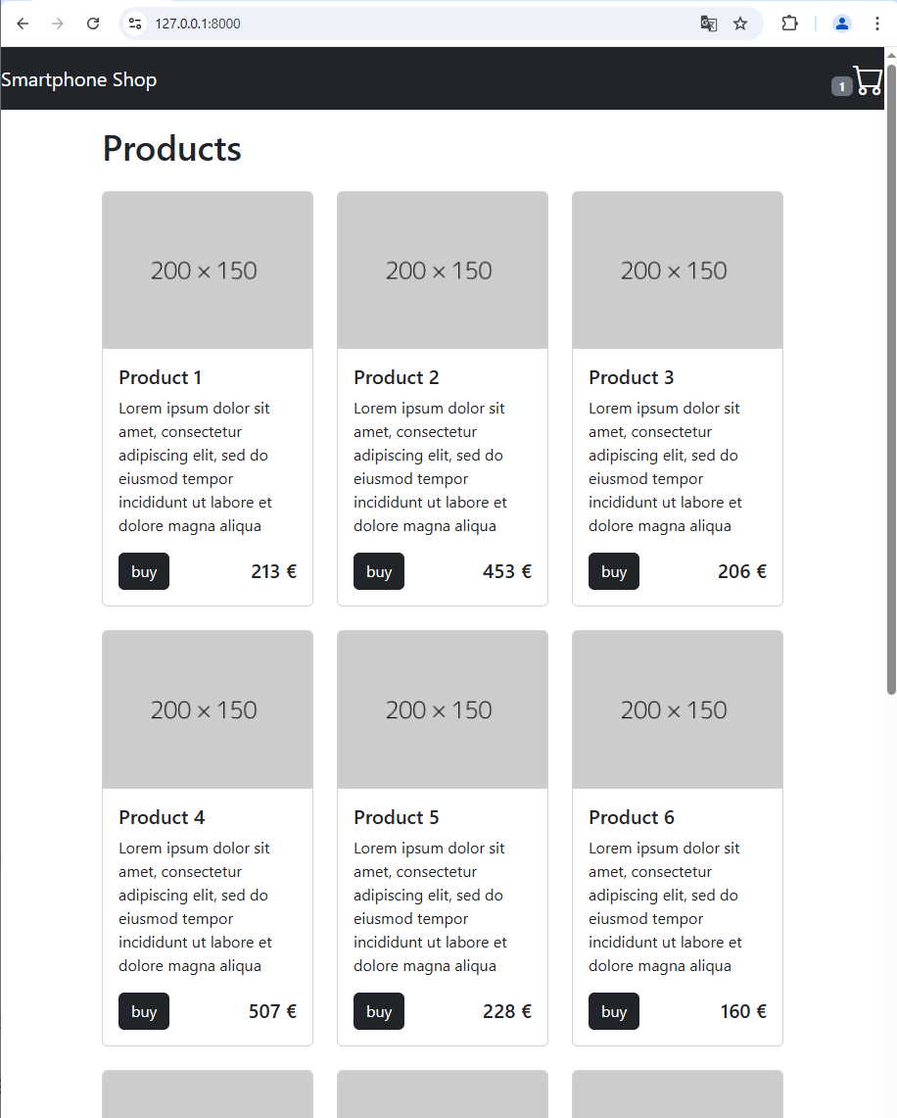
Stap 1: toon producten

Slide 5
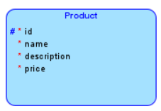
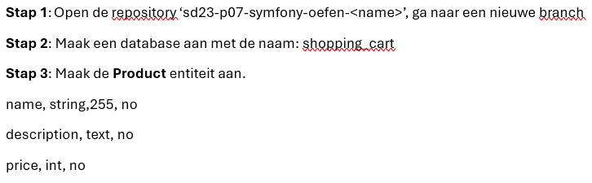
Maak product entity

Slide 6
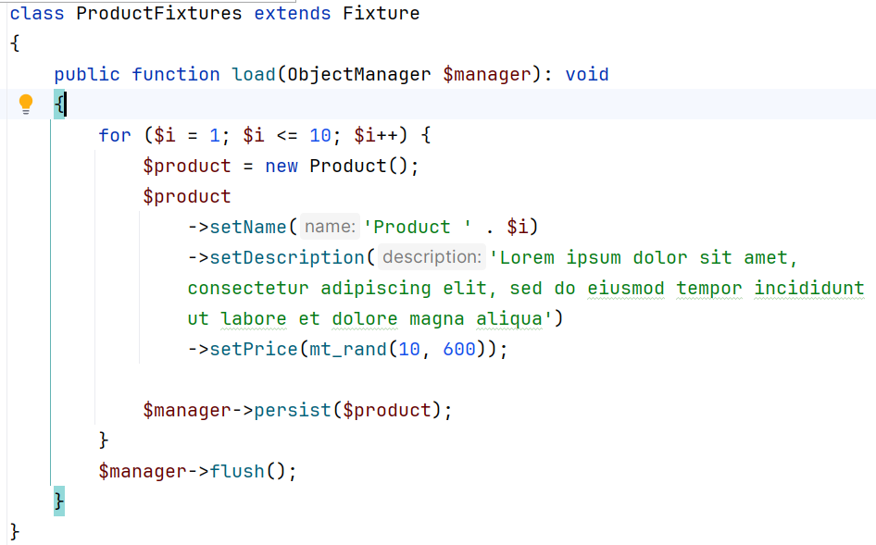
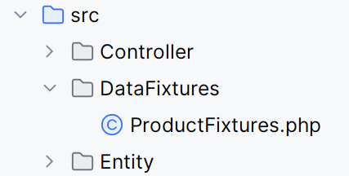
Tabel vullen met test data (fixtures)

Slide 7

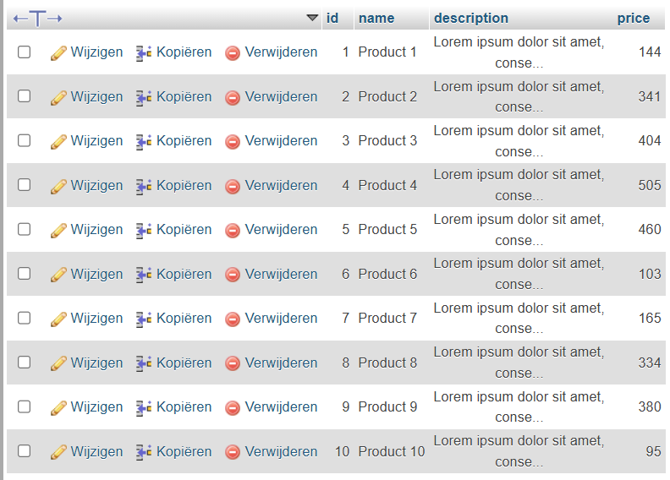
Inhoud product tabel na laden fixtures (nice☺)

Slide 8
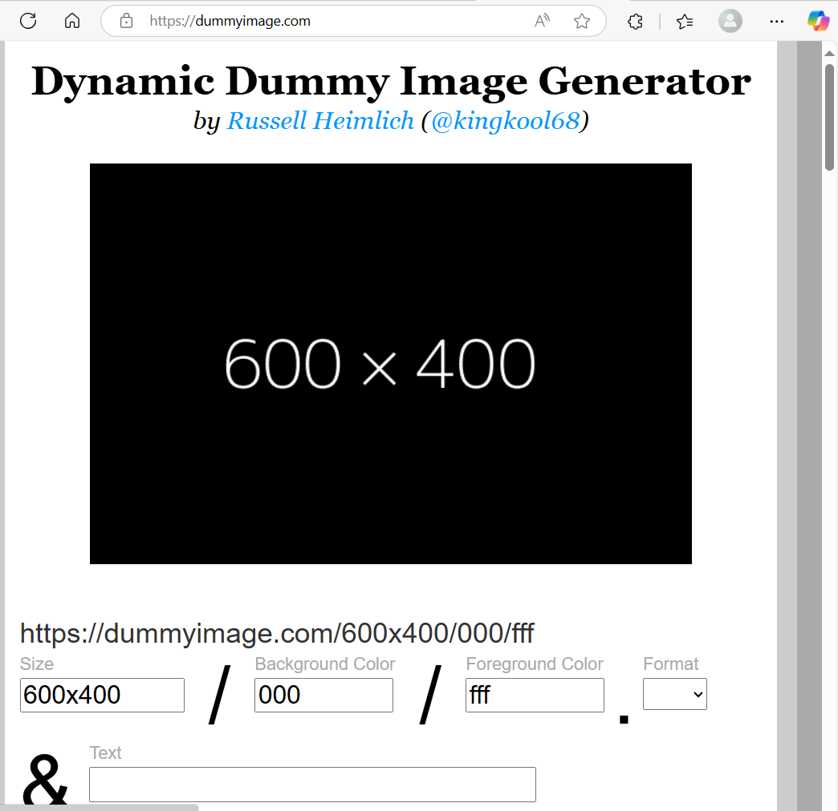
Tonen images
www.dummyimage.com

Slide 9
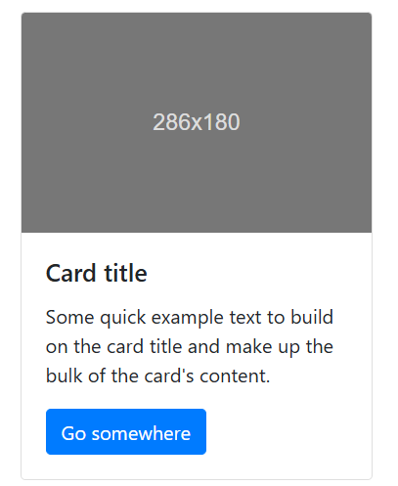
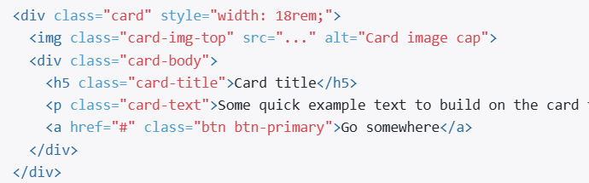
Tonen product, bootstrap Card

Slide 10
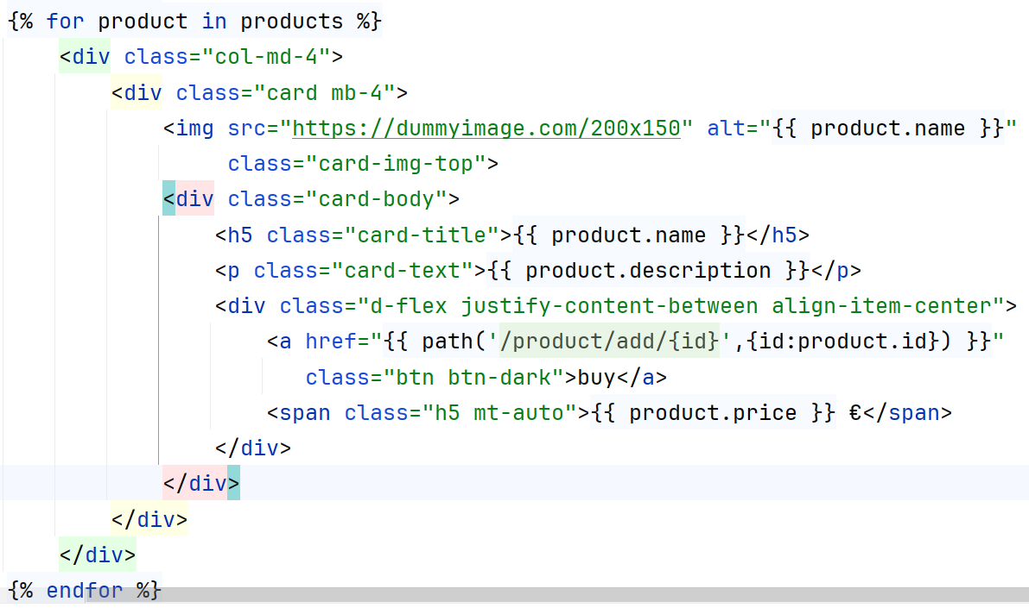
Tonen producten

Slide 11
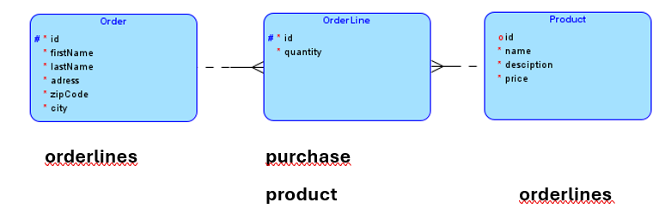
Stap 2 Maak de database (ERD)

Slide 12
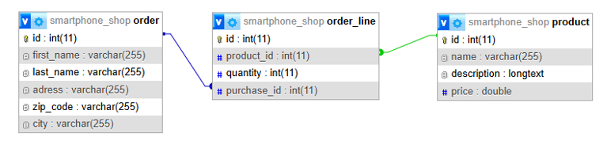
Stap 2 De database (tabellen)

Slide 13
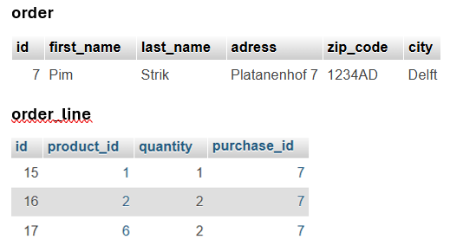
Stap 2 Voorbeeld data
Pim strik koopt 5 producten. 1x product1 2x product2 en 2xproduct6

Slide 14
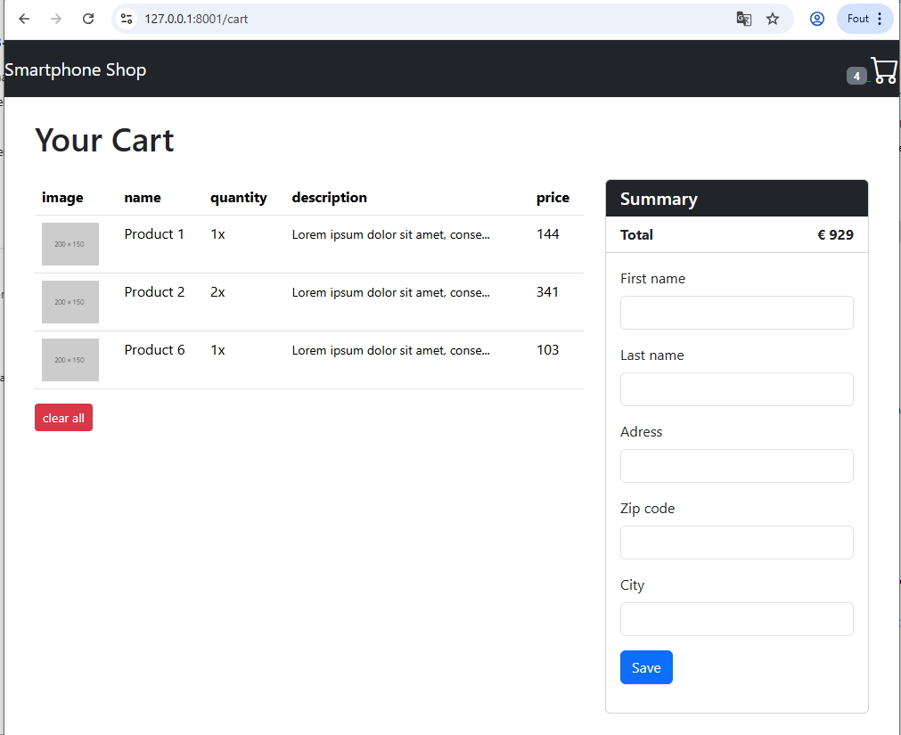
Stap 3: Toon de winkelmand

